Slide 1
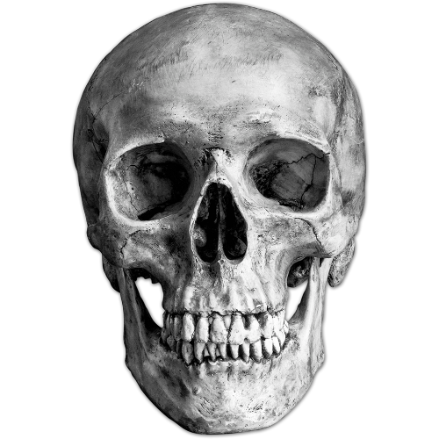
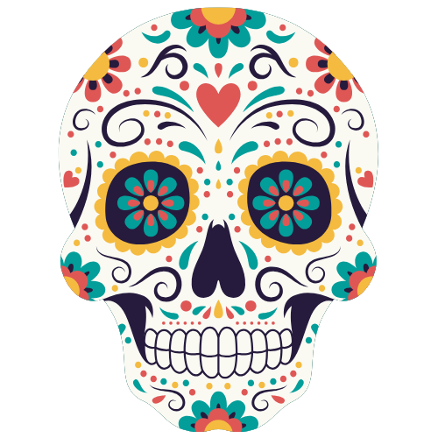

Día de muertos
Notes:
Teacher notes: Title. Some students may associate it with Halloween because the celebrations take place around the same time of year but they have different histories, traditions, and meanings.
Ask: What do you know about Día de Muertos?
About this presentation: This resource focuses on Día de Muertos traditions in Mexico. Traditions vary across Mexico, and other countries have their own ways of honoring and remembering the dead.

Slide 2
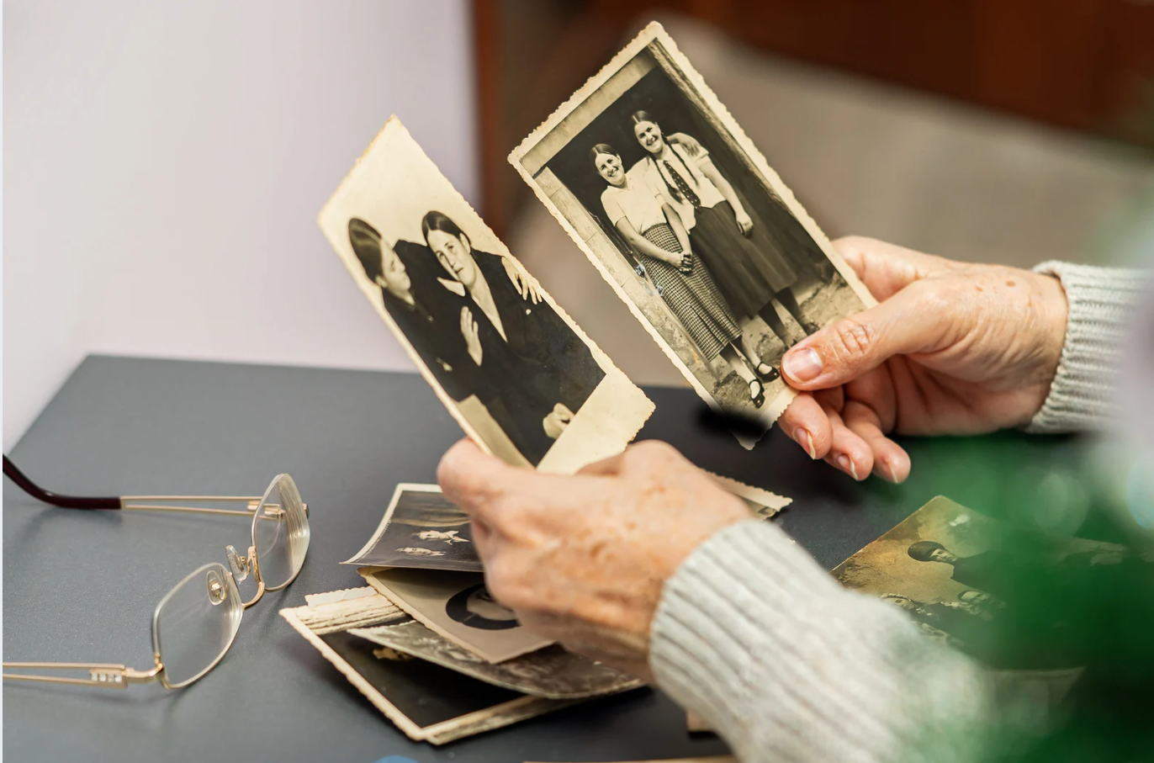
What is Día de Muertos?
Día de Muertos is a Mexican tradition that honors and remembers loved ones who have died.
It is a time to remember and celebrate their lives!
Notes:
Teacher Notes: Explain that Día de Muertos is not simply about mourning someone who has died. It is also a time to remember the person and celebrate their life.
Ask: Have you heard the expression “Celebration of Life”? What do you think it means?
Optional:

Slide 3
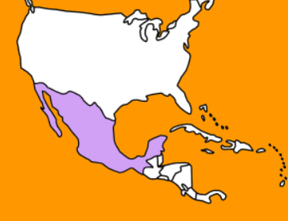
Where did Día de Muertos come from?
Some of its traditions have roots in ancient cultures in Mexico.
Many indigenous cultures honored and remembered the dead long before the Spaniards arrived.
Notes:
Teacher Notes: Before the Spanish arrived, different cultures in what is now Mexico had their own traditions and beliefs related to death and the afterlife. The following slides introduce a few ideas that help students understand this history.
But before continuing, briefly review what students know about the arrival of the Spaniards in Mexico.
Ask: -Can you name a civilization that lived in Mexico before de Spaniards arrived?
- What do you know about the Aztecs?
- Do you remember when the Spaniards arrived?
Optional: Briefly talk about the arrival of the Spaniards, perhaps comparing it with the arrival of English settlers in what is now the United States. Explain that Spain began its conquest of Mexico much earlier, in the early 1500s. The Aztec capital, Tenochtitlan, fell to Spanish-led forces in 1521.

Slide 4
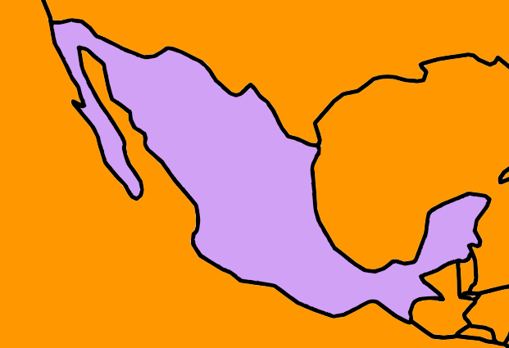
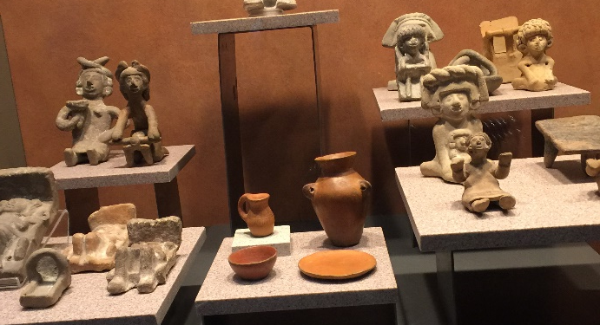
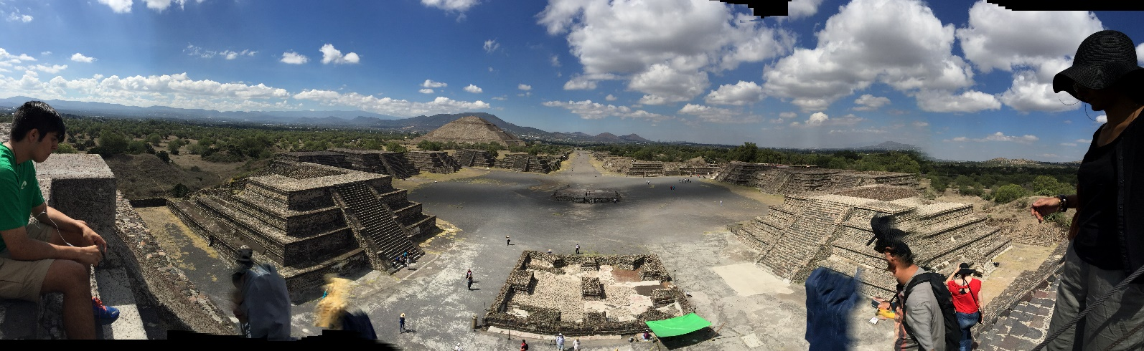
Ancient Traditions
The Teotihuacans were people who lived about 2,000 years ago, before the Aztecs
They lived in central Mexico
They honored their dead and buried them with objects for their
journey after death
Teotihuacán
Notes:
Teacher Notes: Teotihuacán was a large ancient city in central Mexico. Archaeological evidence shows that its people buried the dead with offerings and personal objects. Some burials were located beneath homes and patios.

Slide 5
From the Teotihuacans
to the Aztecs
Spaniards arrive
2026
Today
Teotihuacans
300 BCE - 900 CE
Aztecs
1300 - 1521
The Aztecs flourished centuries after Teotihuacans and lived in the same region
Like earlier cultures, they also honored the dead
Notes:
Teacher Notes: Teotihuacán began to develop around 300–100 BCE and reached its height during the Classic period (200–900 CE). The Aztecs (Mexica) rose to prominence much later, during the 1300s, and their empire ended with the Spanish conquest in 1521.
Optional: Centuries after Teotihuacán was abandoned, the Aztecs encountered its enormous pyramids and considered the site sacred. They believed it was a place connected with the creation of the Sun and the Moon. The name Teotihuacán comes from the Nahua peoples who encountered the ancient city; it is commonly understood as “the city/place of the gods.”
The Aztecs continued to regard Teotihuacán as a sacred place and performed rituals there.

Slide 6
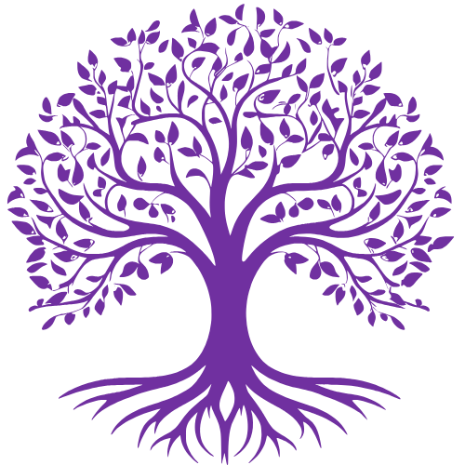

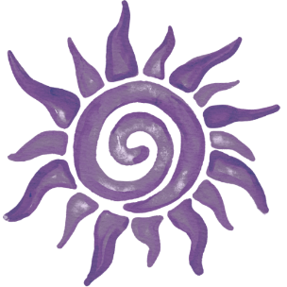
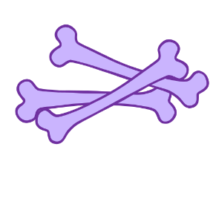
What did the Aztecs believe about death?
Have you heard where people go after they die?
For the Aztecs, where people went after death did not depend on whether they had been “good” or “bad.”
It depended mainly on how they died:
Tlalocan Tonatiuhichan Chichihualcuauhco Mictlán
Notes:
Teacher Notes: The Aztecs believed that a person's destination after death depended largely on how the person died, rather than on whether the person had lived a morally “good” or “bad” life. Different types of death were associated with different destinations in the afterlife.
Ask: Ask students to think about the question, but do not require them to answer or share personal beliefs. Explain that different cultures have developed different ideas about what happens after death.
Optional:
Tlalocan: A peaceful place of abundance for people whose deaths were associated with water or rain.
Tonatiuhichan (House of the Sun): Associated with warriors who died in battle and women who died in childbirth, among others.
Chichihualcuauhco: A place for babies and very young children, where a nursing tree provided nourishment.
Mictlán: The destination for most people who died a natural death. Reaching Mictlán involved a long and difficult journey.

Slide 7
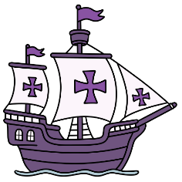
1521: The Spaniards Arrive
The Spaniards brought new traditions
and new beliefs about death.
Notes:
Teacher Notes: In 1521, Tenochtitlan fell to Spanish-led forces, marking the end of the Aztec Empire and the beginning of the colonial period. The Spaniards brought their language, religion, and traditions.
Ask: Do you know why Mexicans speak Spanish? Do you know why we speak English in the United States?
Optional: Remind students that the Spaniards came from Europe and conquered territories in the Americas. This can also be a good opportunity to make a connection between European colonization and the languages spoken in the Americas today.
For example, students can think about the connection between England → English → the United States and Spain → Spanish → many Spanish-speaking countries in the Americas.
This discussion is optional and can be as brief or as detailed as appropriate for your students.

Slide 8
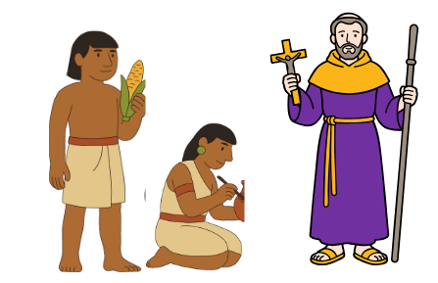
Catholic Traditions
The Spaniards were Catholic
They brought their religious traditions to Mexico.
One of these traditions was:
All Souls’ Day on November 2:
A day to remember and pray for people who have died.
Notes:
Teacher Notes: Spanish colonization also brought Catholicism to Mexico. Missionaries worked to convert Indigenous peoples to Christianity. This introduced new religious traditions and ideas about death and the afterlife.
All Souls’ Day is a Catholic tradition observed on November 2. It is a day to remember and pray for people who have died. There is no need to discuss Catholic beliefs in detail. The purpose here is simply to help students understand the historical connection between November 2 and the tradition of remembering the dead.
Ask: What are some religions you have heard of?

Slide 9
The Two Cultures Meet
New traditions developed over time
Indigenous
celebration
Catholic
traditions
Día de Muertos
Notes:
Teacher Notes: Día de Muertos developed over a long period of time. Indigenous traditions of honoring the dead interacted with Catholic traditions introduced during the colonial period. These traditions changed and developed in different ways in different parts of Mexico.

Slide 10
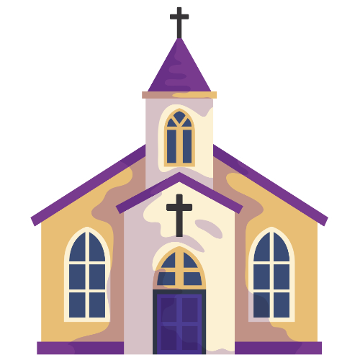
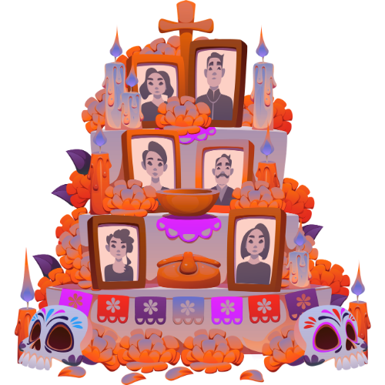
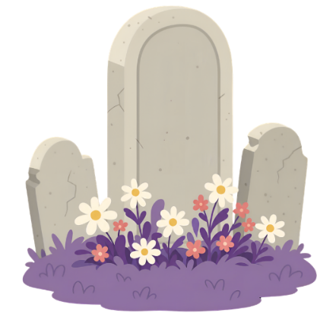
Día de Muertos Today in Mexico
Families remember and honor loved ones
in different ways:
At church At the cemetery At home
Notes:
Teacher Notes: Día de Muertos traditions vary across Mexico and from family to family. This presentation looks at three places where families may remember loved ones who have died: at home, at the cemetery, and at church. Not all families follow all of these traditions. These practices reflect traditions that have developed and changed over centuries.
Ask: Have you seen any of these traditions before?

Slide 11
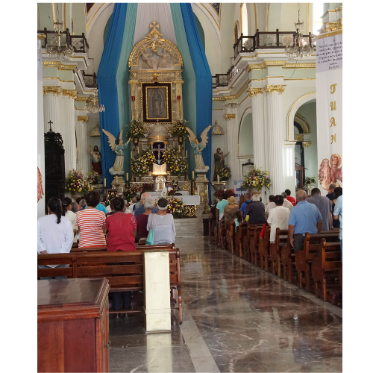
At Church
Some families attend Mass, a Catholic religious service.
Here they remember and pray for loved ones who have died.
Notes:
Teacher Notes: Some Catholic families attend Mass as part of their Día de Muertos observance. This reflects the Catholic traditions that became part of the celebration after the arrival of the Spaniards.

Slide 12
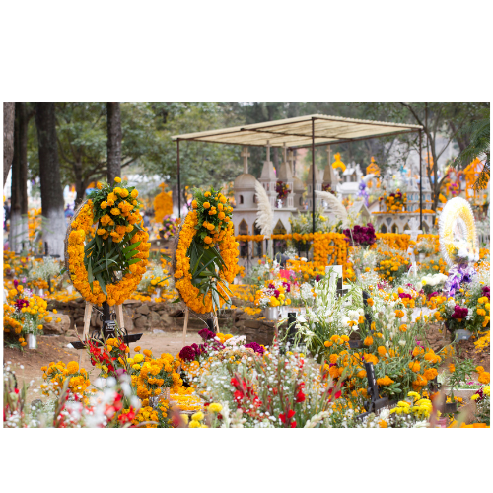
At the Cemetery
Some families visit the cemetery and clean and decorate the tomb with flowers.
They may gather there to remember and celebrate the life of their loved one. Some families even bring music.
Notes:
Teacher Notes: Visiting cemeteries and caring for the graves of loved ones around these dates can be found in both Mexican Día de Muertos traditions and Catholic observances in other countries. The way this is done, however, reflects different cultures and local traditions.
In Mexico, some families may decorate graves with flowers, bring food, spend time together, or even bring music that the deceased enjoyed. In countries such as Poland, visiting and decorating family graves around All Saints’ Day is also an important tradition, but the observance is generally more solemn.
Ask: Why do you think a family might bring the person’s favorite music?
Optional: Ask students how the same tradition might look different when it becomes part of different cultures.

Slide 13
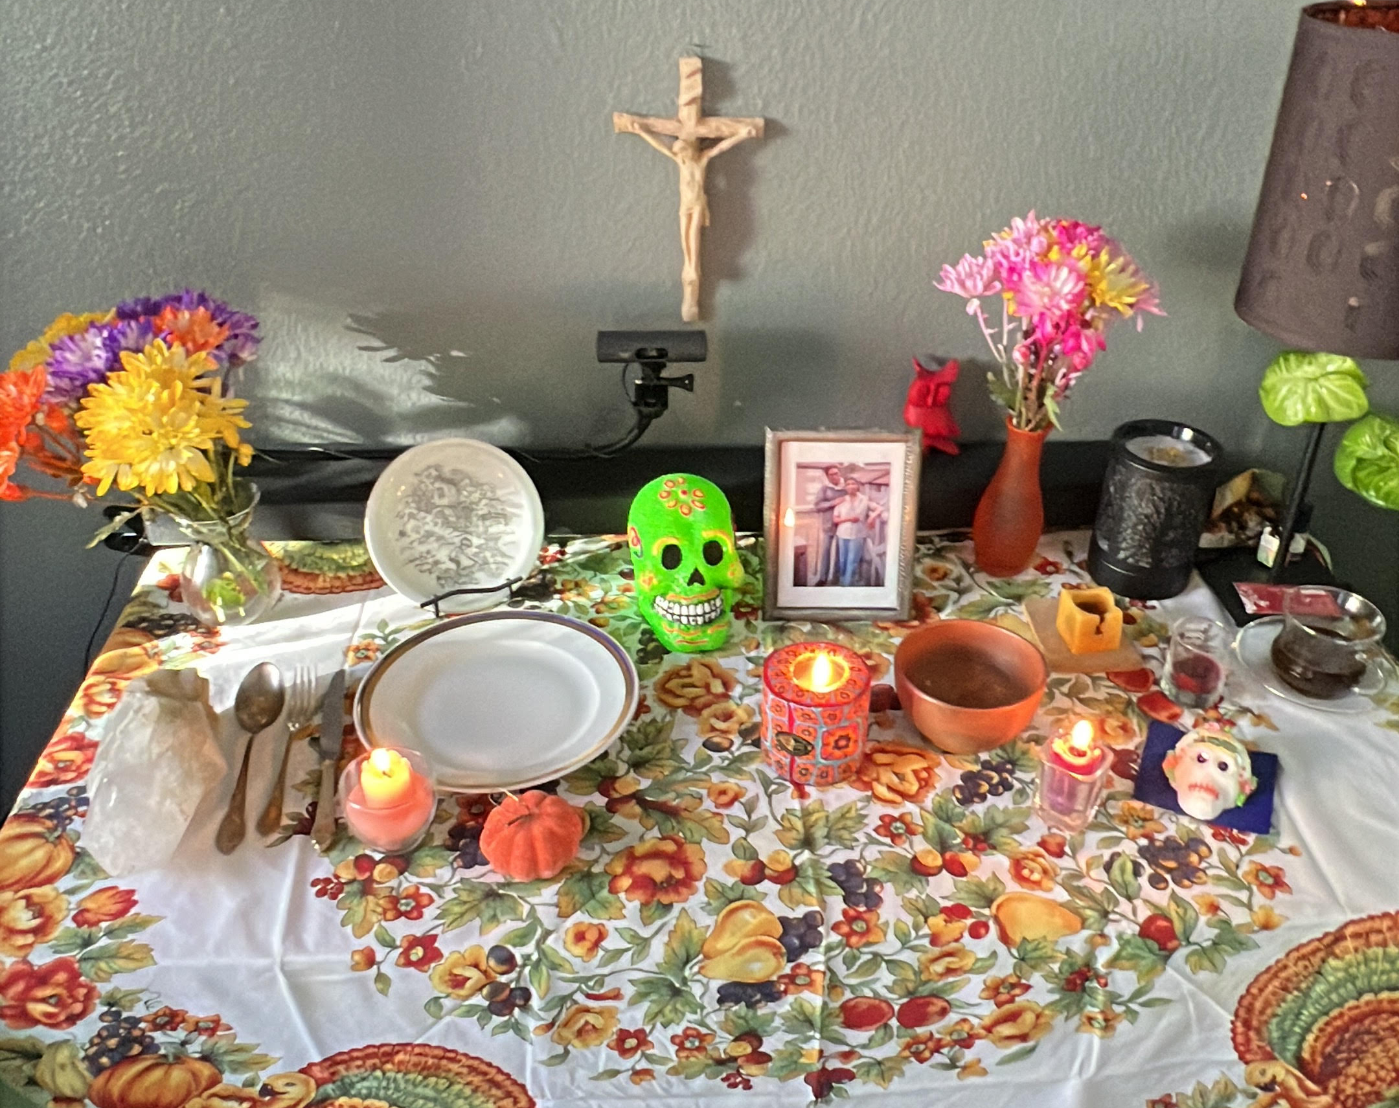
At Home: El Altar de Muertos
Families create an Altar de Muertos
to welcome loved ones who have died.
Notes:
Teacher Notes: An altar de muertos is also commonly called an ofrenda. Both terms are used for the space families prepare to remember loved ones who have died.
Ask: What do you see?
Optional: Explain the meaning of the words altar and ofrenda. Altar is similar to the English word altar, and ofrenda means offering. You can ask your students: What do you think altar means? Does it look like an English word you know?
What do you think ofrenda means (offering)?

Slide 14
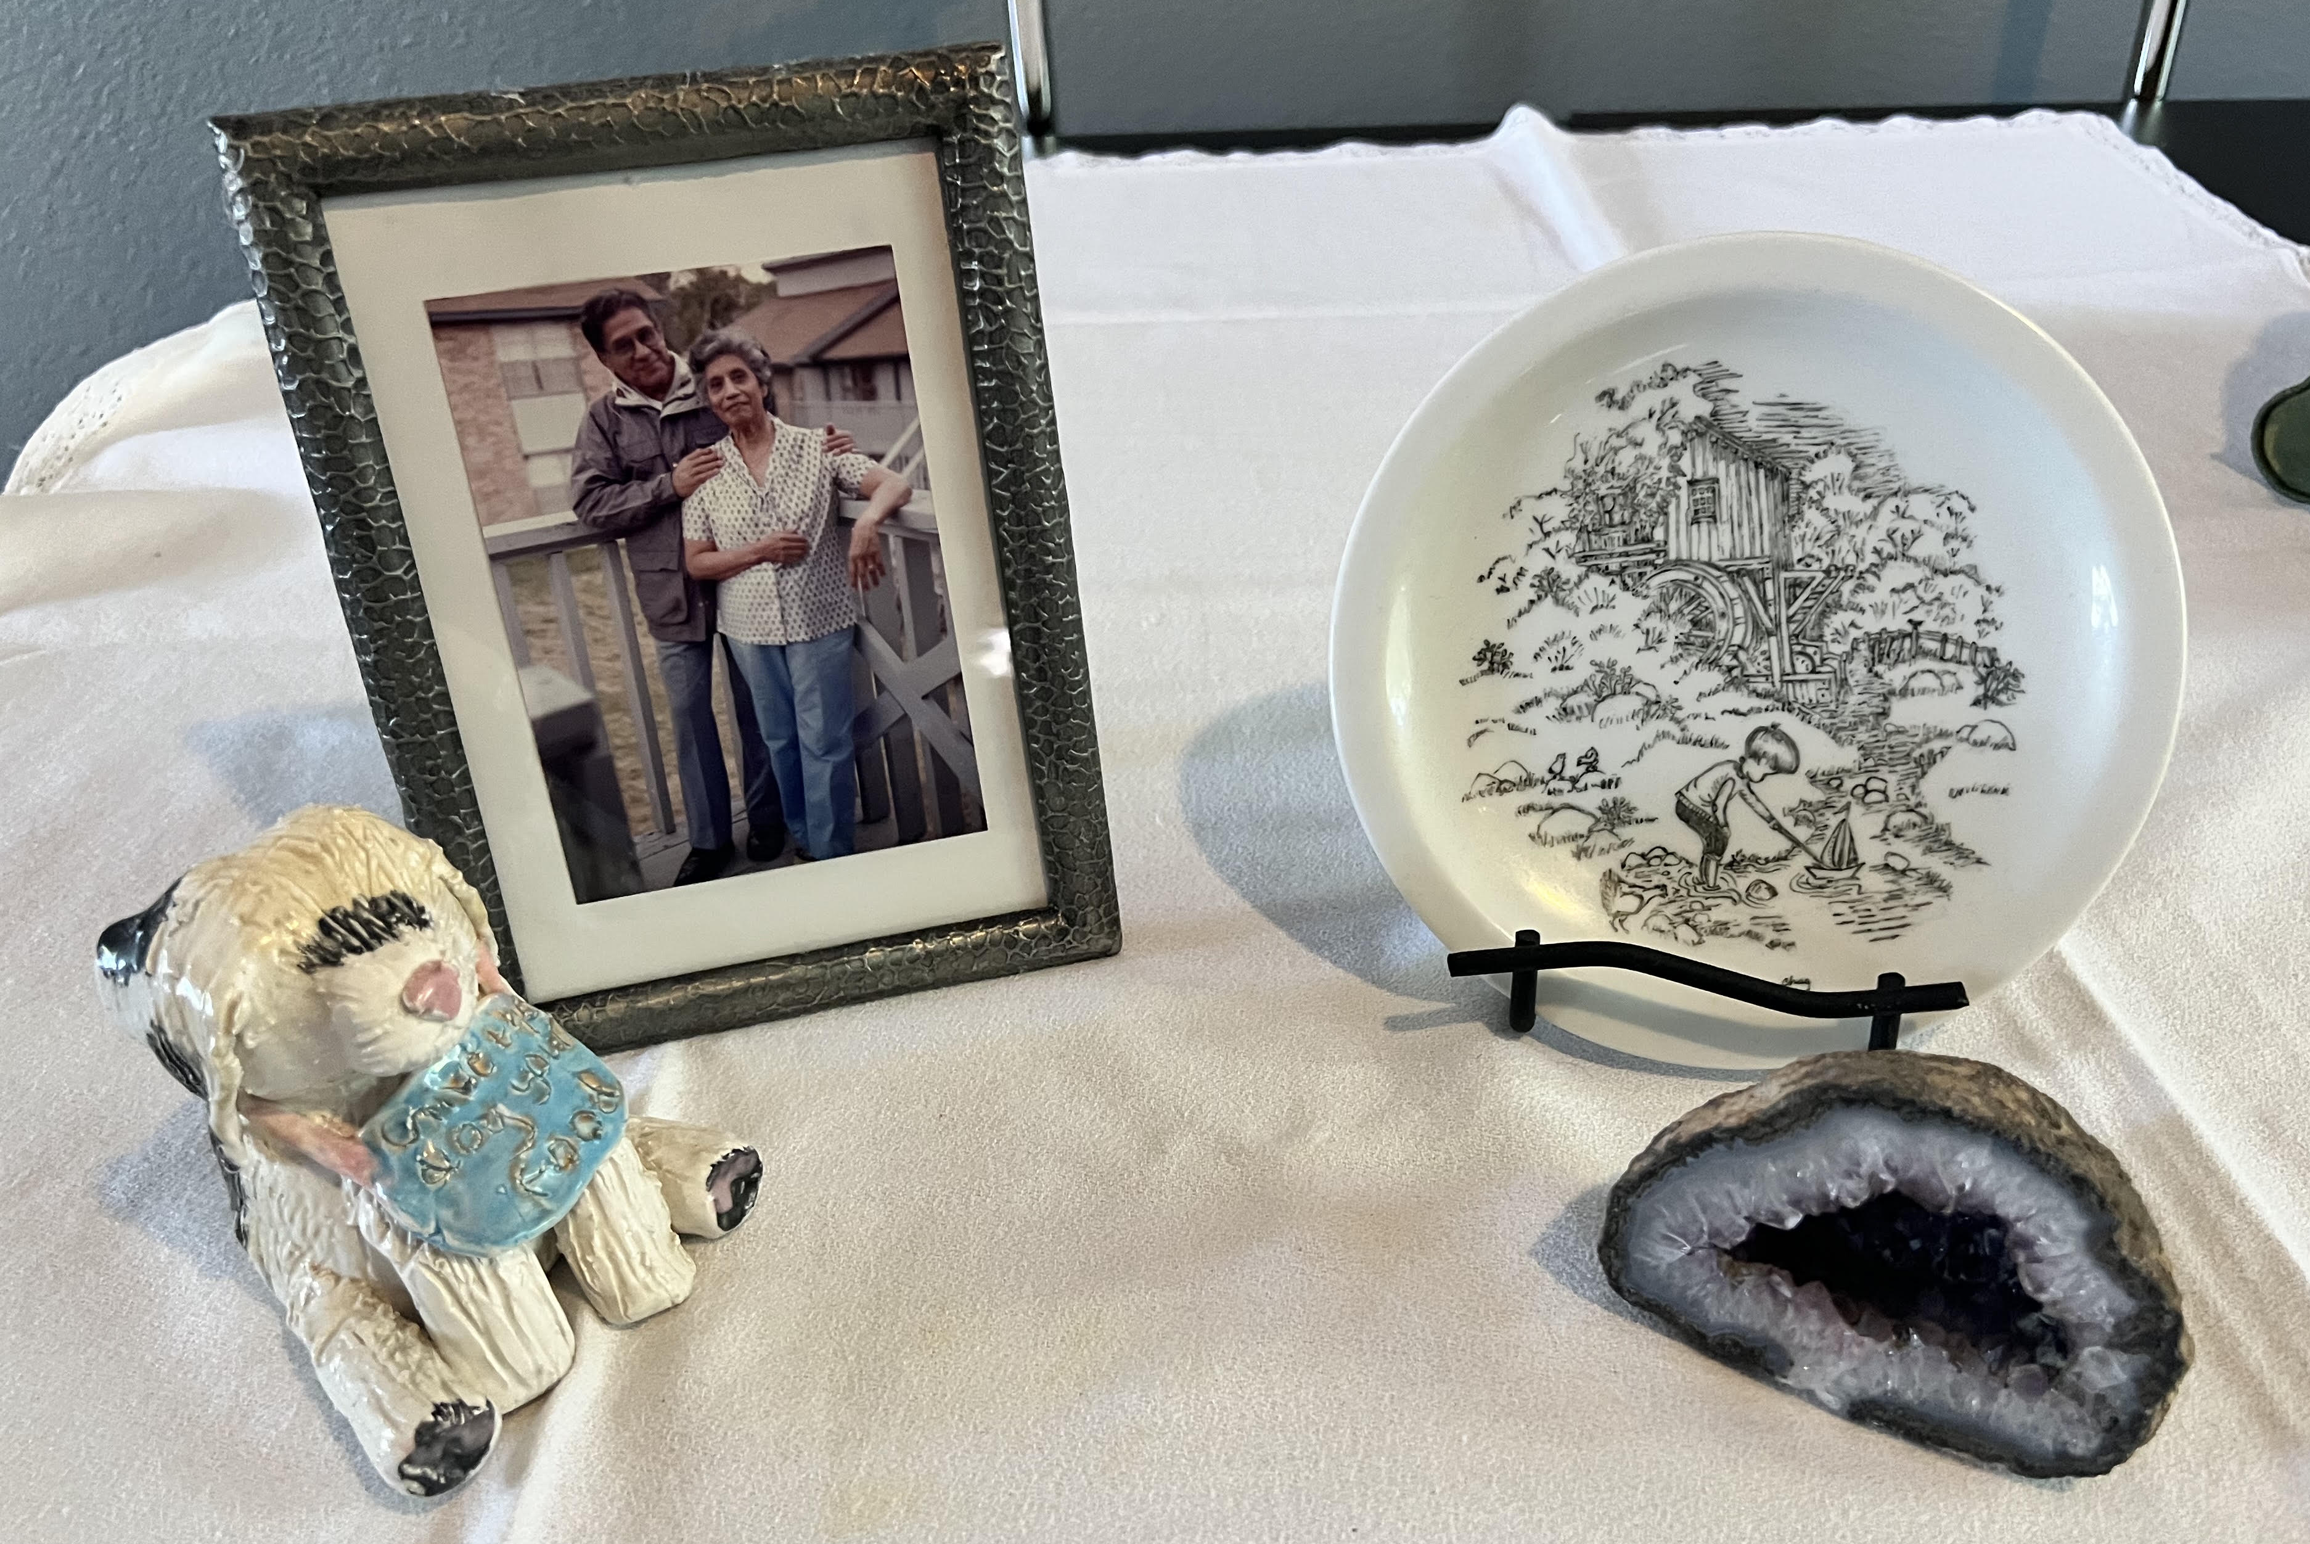
Who is Coming?
Photographs
show the person we are remembering
Personal objects
remind us of the person and their life
Notes:
Teacher Notes: Photographs and personal objects help families remember the person and share stories about their life. The objects may represent things the person owned, enjoyed, collected, or cared about. They can also help younger family members learn about relatives they may never have known.
Ask: What objects do you see? Why do you think there is a rock, a painted plate, and a dog on the altar?
Example: The rock represents someone who was a mining engineer. The plate was painted by the person being remembered. The dog represents a beloved pet that had died.
Optional: Ask the kids: What object would help someone remember you?

Slide 15
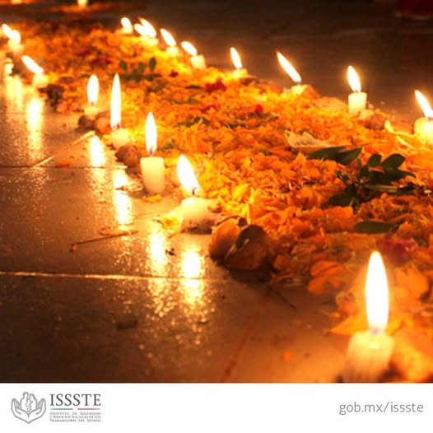
Finding the Way Home
Path of flowers
to guide the souls home
Candles
to light the way
Notes:
Teacher Notes: Marigold petals (cempasúchil) may be used to create a path leading to the altar. Their bright color and scent are traditionally believed to help guide the souls home. Candles provide light to help them find their way.
Optional: Introduce the word cempasúchil, the traditional marigold used for Día de Muertos.

Slide 16
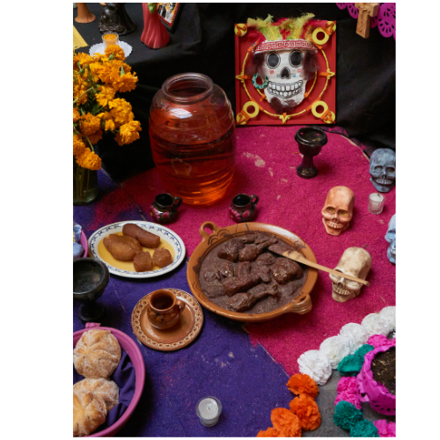
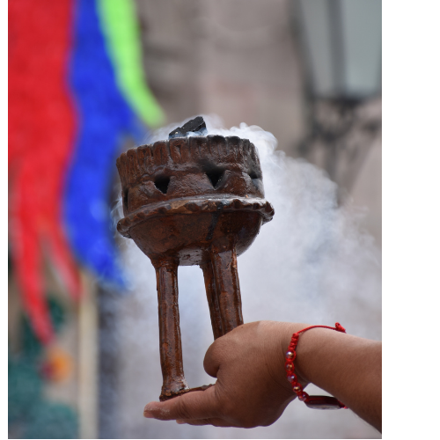
Welcoming Them Home
Food and water
to help the souls rest,
feel loved, and refresh themselves after their journey.
Copal
to purify the space
Notes:
Teacher Notes: Families may place the loved one’s favorite foods and drinks on the altar. Water is traditionally offered to refresh the souls after their journey. The food and drinks also help create a welcoming place for the returning loved one. Traditionally, copal is believed to help keep away harmful or unwanted spirits.
Ask: Have you ever smelled incense or a scented candle? What did it smell like?
Optional: Copal is an aromatic resin that is burned in a way similar to incense. Its fragrant smoke has been used in Indigenous ceremonies in Mexico since before the arrival of the Spaniards. Students may recognize the idea of burning incense from other religious or cultural traditions.

Slide 17
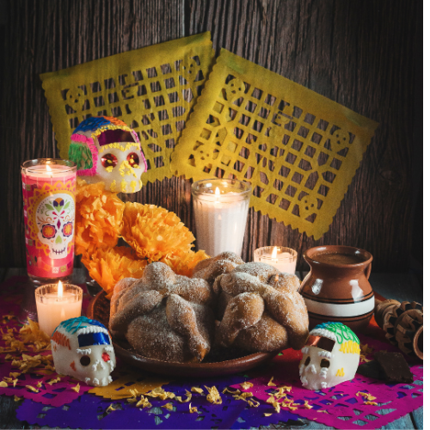
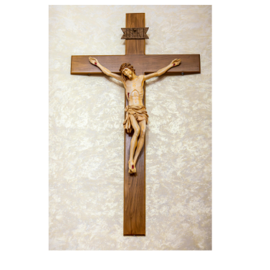
What Else Is on the Altar de Muertos?
Papel picado,
colorful cut-paper decorations
Calaveras,
decorated skulls
Cross,
a Catholic symbol
Pan de Muerto,
traditional bread
Notes:
Teacher Notes: These are some other elements students may see on an Altar de Muertos. Altars vary by region and family, so not every altar includes all of these elements.
Calaveritas are often colorful and playful representations of skulls rather than frightening ones.
Pan de Muerto is a traditional bread prepared for Día de Muertos; the decorations on top often resemble bones.
Papel picado adds color and movement and is sometimes associated with air or wind.
The cross reflects the Catholic influence on Día de Muertos traditions.
Ask: Which of these have you seen before?
Optional: In Mexico, sugar or chocolate skulls may be decorated with people’s names and given to friends or family members. They are playful Día de Muertos treats, not frightening messages.

Slide 18
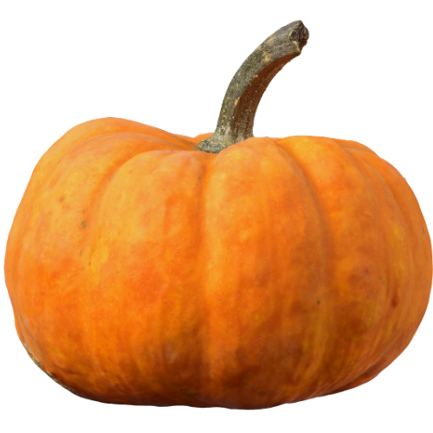
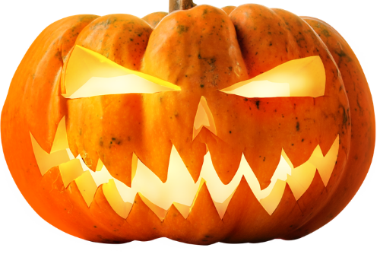
Halloween and Día de Muertos
Halloween
Día de muertos
Notes:
Teacher Notes: Remind students of what they learned about the origins of Halloween. In the traditions discussed in that presentation, people tried to protect themselves from spirits or keep them away. In Día de Muertos traditions, families prepare to welcome the spirits of loved ones who have died.
Ask: What is different about the way the two traditions view spirits?

